Slide 1

MACHINE LEARNING ASSIGNMENT
Unsupervised Learning
Clustering & Association Rule Mining — Finance Domain
K-Means
Hierarchical
Apriori

Slide 2
Unsupervised Learning — Core Concepts
FOUNDATIONS
WHAT IS IT?
WHERE IT'S USED
Machine learning on unlabeled data. The model finds hidden patterns, groupings, or relationships on its own — there is no predefined output label to predict.
Customer segmentation & profiling
Market basket / cross-sell analysis
Anomaly & fraud detection
Recommendation systems

Slide 3
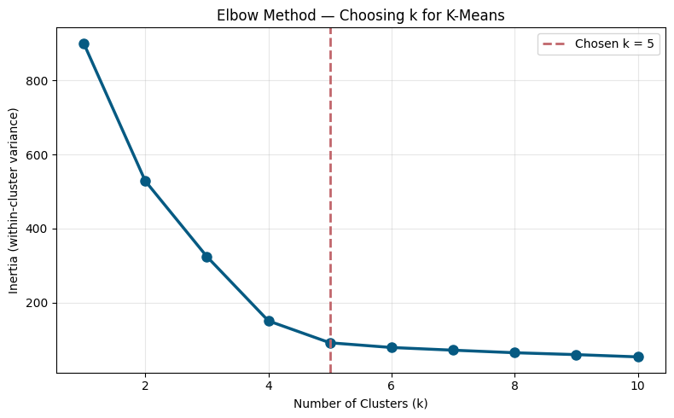
K-Means — Choosing k
CUSTOMER SEGMENTATION
KEY TAKEAWAYS
k = 5 gives the best trade-off (Silhouette ≈ 0.59)
Optimal k locked in before running K-Means

Slide 4
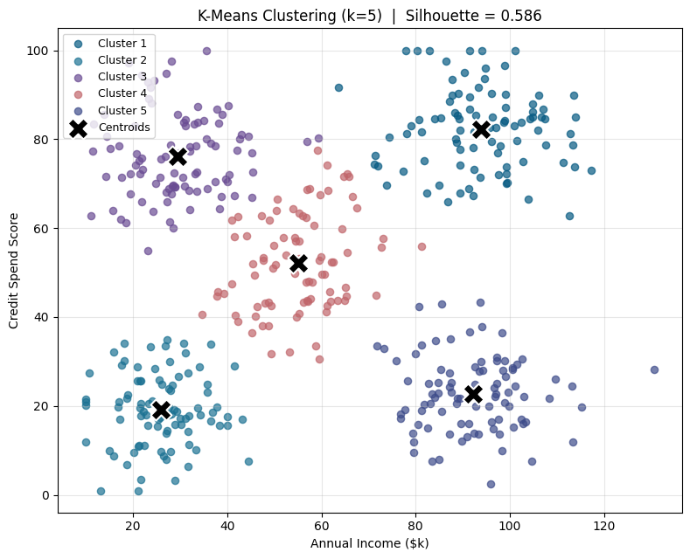
K-Means Clustering (k=5)
CUSTOMER SEGMENTATION
KEY TAKEAWAYS
Customers grouped into 5 distinct segments
Segments separated by balance and spending behaviour
Enables targeted marketing per segment

Slide 5

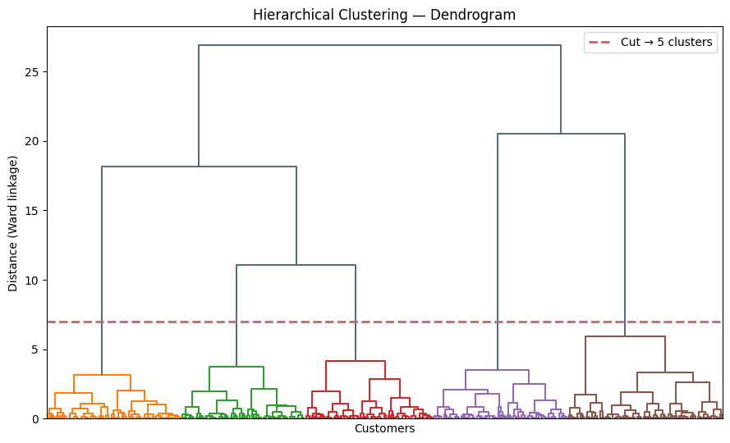
Hierarchical Clustering
DENDROGRAM
KEY TAKEAWAYS
Dendrogram built using Ward's linkage
Confirms 5 natural clusters, no k needed upfront
Cross-validates the K-Means segmentation

Slide 6

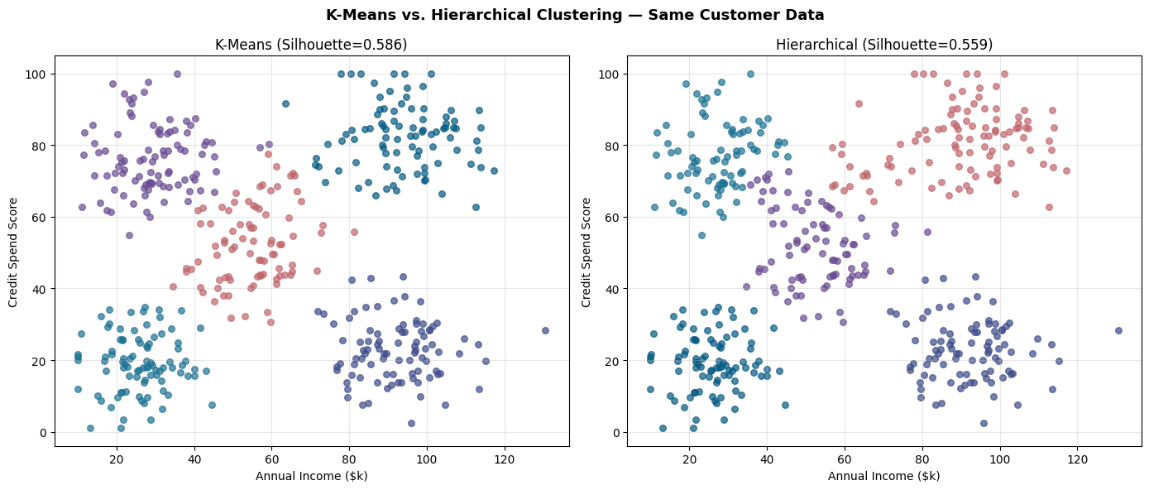
K-Means vs. Hierarchical
SAME DATA, TWO ALGORITHMS
KEY TAKEAWAYS
Both algorithms produce highly similar segments
Silhouette: K-Means 0.59 vs. Hierarchical 0.56
K-Means preferred for speed on larger datasets

Slide 7

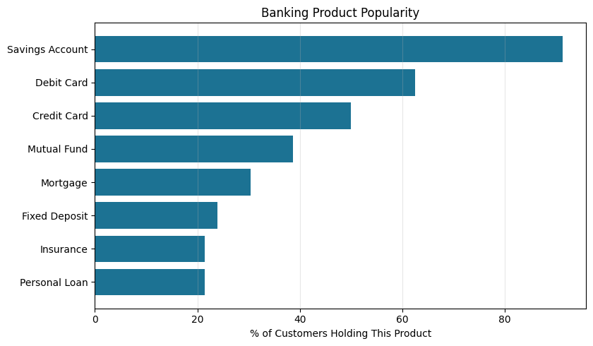
Association Rule Mining
BANKING PRODUCT HOLDINGS
KEY TAKEAWAYS
Apriori applied to customer product-holding data
Frequent itemsets mined above a minimum support
Shows which products are commonly held together

Slide 8
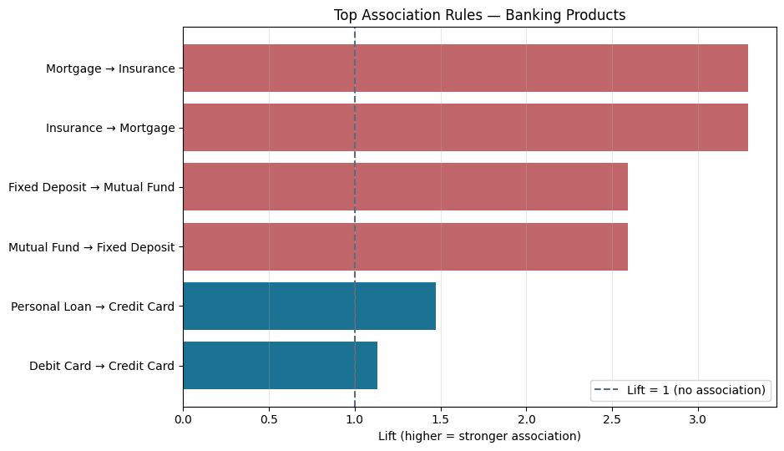
Top Association Rules
APRIORI · BY LIFT
KEY TAKEAWAYS
Rules ranked by lift to find strongest links
Insurance → Mortgage is the top rule (lift 3.3)
Highlights the strongest cross-sell opportunities

Slide 9
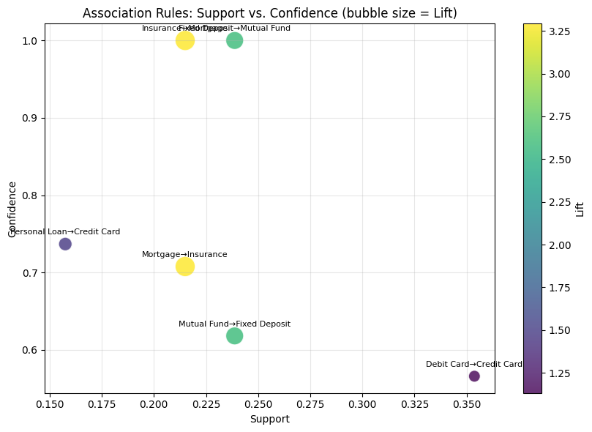
Support vs. Confidence
BUBBLE SIZE = LIFT
KEY TAKEAWAYS
Each bubble represents one association rule
Bubble size encodes rule strength (lift)
Helps prioritize rules for business action

Slide 10

Summary
RECAP
Technique | Use Case | Key Result
K-Means | Customer Segmentation | 5 segments, Silhouette 0.59
Hierarchical | Same segmentation, no k needed upfront | Silhouette 0.56
Apriori (Assoc. Rules) | Cross-sell recommendations | Insurance → Mortgage (lift 3.3)

Slide 11
THANK YOU

